Slide 1
Support Vector machines Classifier

Slide 2
Introduction
Support Vector Machines (SVM) are a powerful class of supervised machine learning algorithms primarily used for classification and regression tasks.
They are particularly well-suited for tasks where the goal is to separate data points into different classes or groups.
At its core, SVM aims to find the optimal hyperplane that best separates data points of different classes in a high-dimensional space.
This hyperplane serves as the decision boundary, allowing SVM to classify new, unseen data points based on their position relative to this boundary.

Slide 3
Features of SVM
Maximizing Margin: SVM's primary objective is to maximize the margin, which is the distance between the decision boundary (hyperplane) and the nearest data points from each class.
  This maximization helps SVM achieve robust generalization to new data.
Support Vectors: Support vectors are the data points that lie closest to the decision boundary.
  They play a crucial role in defining the hyperplane and determining the SVM's performance.
Linear and Non-Linear Classification: SVM can be used for both linear and non-linear classification tasks.
  In the linear case, it finds a straight-line hyperplane, while in the non-linear case, it employs kernel functions to handle more complex decision boundaries.

Slide 4
Linear Separability
Linear separability is a fundamental concept in Support Vector Machines (SVM) and plays a pivotal role in understanding how SVM works.
It refers to the property of data points being separable into distinct classes by a straight-line (in two dimensions) or a hyperplane (in higher dimensions).

Slide 5
Why is Linear Separability Important?
SVM's Objective: SVM aims to find the best hyperplane that separates data points into classes.
  Linear separability ensures that a clear decision boundary (hyperplane) exists.
Margin Maximization: Linearly separable data allows SVM to maximize the margin effectively.
  The margin is the distance between the decision boundary and the nearest data points from each class. A larger margin leads to better generalization.

Slide 6
Non-Linear Separability
It's important to note that not all datasets are linearly separable.
In cases where data is not linearly separable, SVM can still be used effectively by employing kernel functions, which allow it to handle more complex decision boundaries.

Slide 7
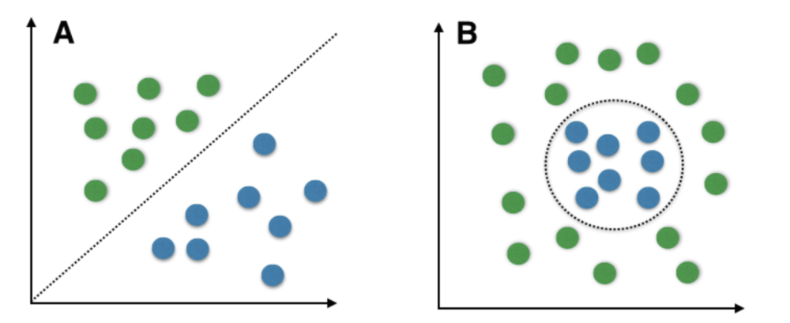
Linearly Separable Vs. Non Linearly Separable data Points

Slide 8
The Margins
In Support Vector Machines (SVM), "margins" refer to the region or space between the decision boundary (hyperplane) and the nearest data points from each class.
Understanding margins is crucial as they are central to SVM's optimization process.
Why Are Margins Important in SVM?
  Maximizing Separation: SVM's primary goal is to maximize the margin.
    A larger margin means a better separation of data points, leading to improved classification performance.
  Robust Generalization: A wide margin results in a more robust model that can generalize better to new, unseen data.
    It helps in reducing overfitting, where the model performs well on training data but poorly on test data.
  Support Vector Identification: The support vectors are the data points closest to the hyperplane and define the margin.
    They are critical in determining the decision boundary and the model's performance.

Slide 9
Soft Margin SVM
In the world of Support Vector Machines (SVM), we often encounter datasets that are not perfectly linearly separable, where a clear hyperplane cannot separate all data points without errors.
In such cases, SVM introduces the concept of a "soft margin."
What is a Soft Margin?
  A soft margin is a modification to the traditional SVM approach that allows for some degree of misclassification of data points.
  It acknowledges the presence of noise or outliers in real-world datasets, making the model more robust.

Slide 10
When is a Soft Margin Used?
Noisy Data: Soft margin SVM is beneficial when the dataset contains noisy or mislabeled data points that are difficult to separate correctly.
Overlapping Classes: In situations where classes overlap to some extent, a hard margin (perfect separation) may not be feasible or result in an overly complex model.
Imbalanced Datasets: Soft margin can be advantageous when dealing with imbalanced datasets, where one class significantly outnumbers the other.

Slide 11
Benefits of Soft Margin SVM
Increased Robustness: Soft margin SVM can handle imperfect datasets and generalize better to unseen data.
Better Convergence: It is often more stable during training as it accounts for minor variations in data.

Slide 12
Support Vectors
Support Vectors are a crucial concept in Support Vector Machines (SVM).
They are the subset of data points that have the closest proximity to the decision boundary (hyperplane) and play a pivotal role in defining and optimizing the SVM model.
Characteristics of Support Vectors
  Closest to the Hyperplane: Support vectors are the data points that lie at the shortest distance from the decision boundary. They are essentially the "border" points.
  Determine Margin: The positions of support vectors dictate the width of the margin. SVM aims to maximize this margin while ensuring that support vectors remain correctly classified.
  Robustness: Since support vectors are the most critical data points, SVM is robust to outliers and noisy data because these anomalies are unlikely to be support vectors.

Slide 13
Hyperplane
In the world of Support Vector Machines (SVM), the term "hyperplane" plays a pivotal role as it defines the decision boundary that separates data points into different classes.
What is a Hyperplane?
  A hyperplane, in SVM, is a flat, high-dimensional surface that acts as the decision boundary.
  In two dimensions (2D), a hyperplane is simply a straight line.
  In three dimensions (3D), it becomes a flat plane.

Slide 14
Purpose of the Hyperplane
The hyperplane's primary purpose is to separate data points from different classes.
It serves as the foundation for SVM's classification process.
Data points are classified based on which side of the hyperplane they fall.

Slide 15
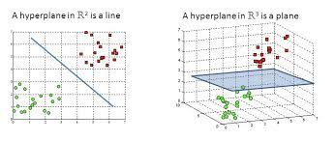
2D and 3D Representation of Hyperplane

Slide 16
Linear SVM
Linear Support Vector Machines (SVM) are a fundamental concept in machine learning, particularly in classification tasks.
They are designed to work with linearly separable data, where a straight-line (in 2D) or a hyperplane (in higher dimensions) can effectively separate the data points into distinct classes.
Key Characteristics of Linear SVM:
  Straight-line or Hyperplane: Linear SVM seeks to find a straight-line (in 2D) or a hyperplane (in higher dimensions) that best separates the data.
  Maximizing Margin: It aims to maximize the margin, the distance between the hyperplane and the nearest data points from each class. A larger margin leads to better generalization.
  Efficiency: Linear SVM is computationally efficient and works well with high-dimensional data.

Slide 17
Advantages of Linear SVM
Simplicity: Linear SVM is conceptually straightforward and easy to implement.
Efficiency: It works efficiently with large datasets and high-dimensional feature spaces.
Generalization: Linear SVM often generalizes well, especially when the data is linearly separable.
Linear SVM is suitable when the data is linearly separable or when simplicity and efficiency are essential for the task.

Slide 18
Limitations of Linear SVM
Limited for Non-Linear Data: Linear SVM performs poorly when data is not linearly separable, as it cannot capture complex decision boundaries.
Sensitivity to Outliers: It can be sensitive to outliers, as outliers may affect the position of the hyperplane.
Less Expressive: Compared to non-linear SVM, it has less expressive power to capture intricate patterns in data.

Slide 19
Kernel Functions
In Support Vector Machines (SVM), "Kernel Functions" are essential tools that enable SVM to handle data that is not linearly separable.
They transform the data into a higher-dimensional space, making it possible to find a hyperplane that can separate non-linearly separable data.
Why Use Kernel Functions?
  Handling Non-Linearity: Many real-world datasets are not linearly separable, meaning a straight line or hyperplane cannot effectively separate the classes.
    Kernel functions allow SVM to handle complex, non-linear decision boundaries.
Avoiding Dimensionality Issues: Kernel functions enable SVM to implicitly operate in a higher-dimensional space.

Slide 20
Types of Kernel Functions
There are several types of kernel functions commonly used in SVM. Here are a few:
  Linear Kernel: The linear kernel is used for linearly separable data. It doesn't transform the data; it uses the original feature space.
  Polynomial Kernel: This kernel transforms the data into a polynomial feature space, allowing SVM to capture non-linear patterns.
  Radial Basis Function (RBF) Kernel: The RBF kernel is one of the most popular choices. It transforms the data into an infinite-dimensional space, making it highly flexible for capturing complex patterns.
  Sigmoid Kernel: The sigmoid kernel is used for problems where the data distribution is not well-known. It is often used in neural network-inspired SVMs.

Slide 21
Q1.Consider the following set of data points given ,find the optimal hyperplane for these data points.
(1,0.5) (1,1) (1,-0.5) (-0.5,-0.5) (0.5,0.5) (2,0) (4,0) (4.5,1) (4.5,0.5) (5,-1) (5.5,0)
Solution:-
Draw all the points on plane
Find the support vectors
Add the bias(b) value to convert 2D to 3D form
Consider parameters for every support vectors like α1, α2 etc
Find the linear equations and solve them to find parameter values
Final equation of hyperplane is

Slide 22
Tuning Parameters
In Support Vector Machines (SVM), there are several key tuning parameters that allow you to customize and fine-tune the model's behavior to achieve the best possible performance for your specific dataset.
C (Cost Parameter):
  Definition: The C parameter controls the trade-off between maximizing the margin and minimizing classification errors on the training data.
  Higher C: Results in a smaller margin but fewer training errors, potentially leading to overfitting.
  Lower C: Results in a larger margin but more training errors, potentially improving generalization.

Slide 23
Tuning Parameters
Gamma (Kernel Coefficient):
  Definition: The gamma parameter determines how far the influence of a single training example reaches.
  Higher Gamma: Leads to a more complex, non-linear decision boundary, potentially causing overfitting.
  Lower Gamma: Results in a simpler, smoother decision boundary, potentially improving generalization.

Slide 24
Tuning Parameters
Kernel Type
  Definition: SVM can use different kernel functions (e.g., linear, polynomial, radial basis function) to transform data into higher dimensions for non-linear classification.
  Choice of Kernel: Depends on the nature of the data and the problem.

Slide 25
Tuning Parameters
Degree (for Polynomial Kernel)
  Definition: In the case of a polynomial kernel, the degree parameter determines the degree of the polynomial used for transformation.
  Higher Degree: Results in a more complex polynomial transformation, potentially overfitting.
  Lower Degree: Leads to a simpler polynomial transformation, potentially improving generalization.

Slide 26
Tuning Parameters
Class Weights
  Definition: SVM allows you to assign different weights to different classes to handle class imbalance issues.
  Use Case: Useful when one class has significantly fewer samples than others.

Slide 27
Tuning Parameters
Convergence Parameters
  Definition: These parameters control the convergence criteria for the SVM optimization algorithm.
  Tolerance (tol): Sets the tolerance for stopping criterion.
  Maximum Iterations (max_iter): Determines the maximum number of iterations for the solver to converge.

Slide 28
Trade-off Parameter (C)
The trade-off parameter 'C,‘ controls the balance between maximizing the margin and minimizing classification errors.
A smaller C allows for a wider margin but permits more misclassifications, while a larger C leads to a narrower margin but fewer misclassifications.
Formula: Soft Margin Objective = Margin + C * (Sum of Classification Errors)

Slide 29
Multi Class SVM
Support Vector Machines (SVM) are naturally designed for binary classification, meaning they distinguish between two classes. However, in many real-world scenarios, we encounter problems with more than two classes.
Multi-class SVM extends the binary SVM to handle such situations effectively.
Challenges in Multi-Class Classification:
  In multi-class classification, there are more than two classes, making the problem more complex.
  Traditional binary SVM cannot be applied directly to these situations.

Slide 30
Approaches for Multi-Class SVM:
One-vs-Rest (OvR) or One-vs-All (OvA)
  In the OvR approach, a separate SVM is trained for each class against the rest.
  For N classes, N different binary classifiers are trained.
  During prediction, all N classifiers are used, and the class with the highest confidence score is selected.
One-vs-One (OvO)
  In the OvO approach, a binary classifier is trained for each pair of classes.
  For N classes, N(N-1)/2 classifiers are trained.
  During prediction, each classifier votes for a class, and the class with the most votes is the winner.

Slide 31
Advantages of Multi-Class SVM
SVM's ability to maximize the margin is preserved in multi-class scenarios, making it robust and reliable.
It can handle complex decision boundaries and is effective in high-dimensional spaces.
Larger datasets often favor OvR, while OvO can be preferable for smaller datasets.

